Slide 1
What is Data Hiding?

Slide 2
Our internal data should not go out directly that is outside person can't access our internal data directly.
By using private modifier we can implement data hiding.
Example: class Account
{
private double balance; ......................; ......................;
The main advantage of data hiding is security. Note: recommended modifier for data members is private.

Slide 3
What is Abstractions ?

Slide 4
Hide internal implementation and just highlight the set of services, is called abstraction. • By using abstract classes and interfaces we can implement abstraction.

Slide 5
Advantages of Abstraction?

Slide 6
We can achieve security as we are not highlighting our internal implementation.(i.e., outside person doesn't aware our internal implementation.)
2. Enhancement will become very easy because without effecting end user we can able to perform any type of changes in our internal system.
3. It provides more flexibility to the end user to use system very easily.
4. It improves maintainability of the application.
5. It improves modularity of the application.
6. It improves easyness to use our system

Slide 7
Security
Easy Enhancement
Maintainability
Modularity
Easyness

Slide 8
What is Encapsulation ?

Slide 9
Binding of data and corresponding methods into a single unit is called Encapsulation .
If any java class follows data hiding and abstraction such type of class is said to be encapsulated class.
Encapsulation=Datahiding+Abstraction

Slide 10
Advantages of Encapsulations ?

Slide 11
Advantages of Encapsulations ?
1. We can achieve security.
2. Enhancement will become very easy.
3. It improves maintainability and modularity of the application.
4. It provides flexibility to the user to use system very easily.

Slide 12
Disadvantages of Encapsulations ?

Slide 13
Disadvantages of Encapsulations ?
The main disadvantage of encapsulation is it increases length of the code and slows down execution.

Slide 14
Tightly encapsulated class ?

Slide 15
A class is said to be tightly encapsulated if and only if every variable of that class declared as private whether the variable has getter and setter methods are not , and whether these methods declared as public or not, these checkings are not required to perform.
Example:
class Account
{
private double balance;
public double getBalance()
{
return balance;
} }

Slide 16
Which one is tightly encapsulated class?
class A { int x=10;
}
class B extends A
{ private int y=20;
}
class C extends B
{
private int z=30;
}

Slide 17
if the parent class is not tightly encapsulated then no child class is tightly encapsulated.

Slide 18
IS-A Relationship?

Slide 19
1. Also known as inheritance.
2. By using "extends" keywords we can implement IS-A relationship.
3. The main advantage of IS-A relationship is reusability.

Slide 20
class Parent {
public void methodOne()
{
} }
class Child extends Parent {
public void methodTwo()
{
} }

Slide 21
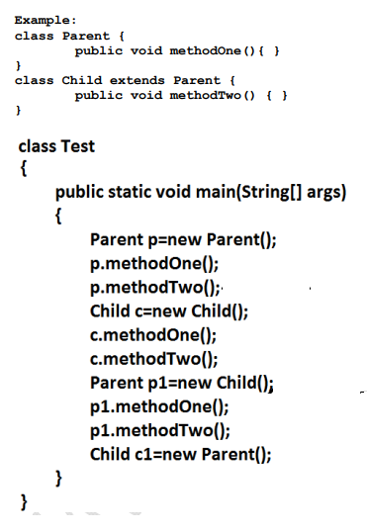

Slide 22
Whatever the parent has by default available to the child but whatever the child has by default not available to the parent. Hence on the child reference we can call both parent and child class methods. But on the parent reference we can call only methods available in the parent class and we can't call child specific methods.
2. Parent class reference can be used to hold child class object but by using that reference we can call only methods available in parent class and child specific methods we can't call.
3. Child class reference cannot be used to hold parent class object.

Slide 23
Multiple inheritance ?

Slide 24
Having more than one Parent class at the same level is called multiple inheritance.
Any class can extends only one class at a time and can't extends more than one class simultaneously hence java won't provide support for multiple inheritance

Slide 25
If our class doesn't extends any other class then only our class is the direct child class of __________

Slide 26
Why java won't provide support for multiple inheritance?

Slide 27
ClassA
M1()
ClassB
M1()
Class C
M1()

Slide 28
Why ambiguity problem won't be there in interfaces?

Slide 29
Interfaces having dummy declarations and they won't have implementations hence no ambiguity problem

Slide 30
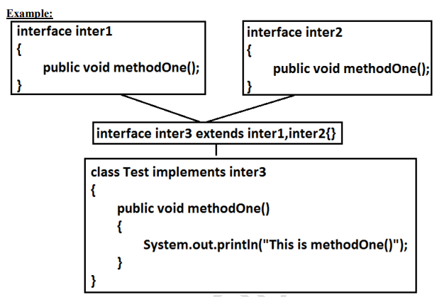

Slide 31
Cyclic inheritance?

Slide 32
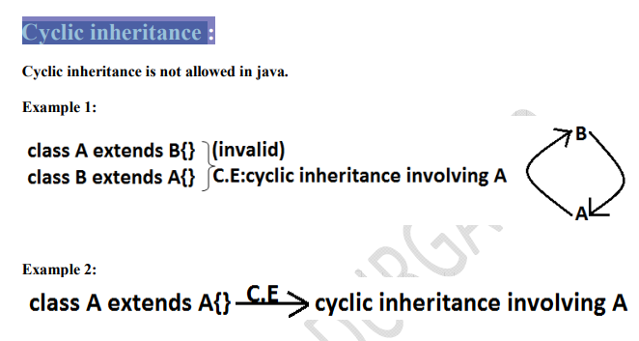

Slide 33
HAS-A relationship?

Slide 34
1. HAS-A relationship is also known as composition (or) aggregation.
2. There is no specific keyword to implement HAS-A relationship but mostly we can use new operator.
3. The main advantage of HAS-A relationship is reusability.

Slide 35
class Engine {
//engine specific functionality
}
class Car
{
Engine e=new Engine();
//........................;
//........................;
//........................;
}

Slide 36
Disadvantages of HAS A ?

Slide 37
Disadvantages of HAS A ?
The main dis-advantage of HAS-A relationship increases dependency between the components and creates maintains problems.

Slide 38
What Composition ?

Slide 39
Without existing container object if there is no chance of existing contained objects then the relationship between container object and contained object is called composition which is a strong association

Slide 40
CAR
College
Engine
Dept.

Slide 41
What is Aggregation ?

Slide 42
Without existing container object if there is a chance of existing contained objects such type of relationship is called aggregation. In aggregation objects have weak association.

Slide 43
CAR
College
Media Player
Professors

Slide 44
What is Method signature?

Slide 45
In java, method signature consists of name of the method followed by argument types.
class Test {
public void m1(double d)
{ }
public void m2(int i)
{ }
public static void main(String ar[])
{
Test t=new Test();
t.m1(10.5);
t.m2(10);
t.m3(10.5); //CE } }

Slide 46
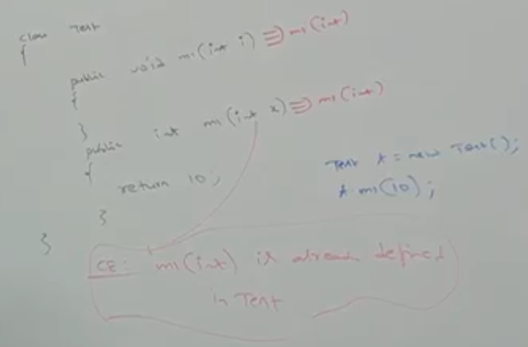

Slide 47
What is Polymorphism:?

Slide 48
Same name with different forms is the concept of polymorphism.

Slide 49
What is Overloading ?

Slide 50
Two methods are said to be overload if and only if both having the same name but different argument types

Slide 51
class Test {
public void methodOne()
{
System.out.println("no-arg method");
}
. public void methodOne(int i) {
. System.out.println("int-arg method"); //overloaded methods }
public void methodOne(double d) {
System.out.println("double-arg method");
}
public static void main(String[] args) {
Test t=new Test();
t.methodOne();
t.methodOne(10);
t.methodOne(10.5);
} }

Slide 52
Automatic promotion in overloading

Slide 53
In overloading if compiler is unable to find the method with exact match we won't get any compile time error immediately.
1st compiler promotes the argument to the next level and checks whether the matched method is available or not if it is available then that method will be considered if it is not available then compiler promotes the argument once again to the next level.
This process will be continued until all possible promotions still if the matched method is not available then we will get compile time error. This process is called automatic promotion in overloading

Slide 54
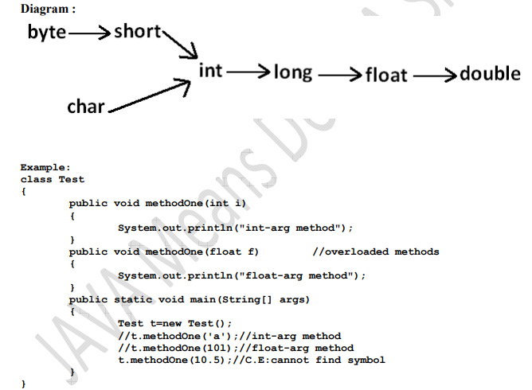

Slide 55
class Test{
public void methodOne(String s)
{
System.out.println("String version");
}
public void methodOne(StringBuffer s)
{
System.out.println("StringBuffer version");
}
public static void main(String[] args){
Test t=new Test();
t.methodOne("arun");
t.methodOne(new StringBuffer("sai"));
t.methodOne(null);
} }

Slide 56
class Test
{
public void methodOne(int i,float f)
{
System.out.println("int-float method");
}
public void methodOne(float f,int i)
{
System.out.println("float-int method");
}
public static void main(String[] args)
{
Test t=new Test();
t.methodOne(10,10.5f);
t.methodOne(10.5f,10);
t.methodOne(10,10);
t.methodOne(10.5f,10.5f);
} }

Slide 57
class Test
{
public void methodOne(int i,float f)
{
System.out.println("int-float method");
}
public void methodOne(float f,int i)
{
System.out.println("float-int method");
}
public static void main(String[] args)
{
Test t=new Test();
t.methodOne(10,10.5f);//int-float method
t.methodOne(10.5f,10);//float-int method
t.methodOne(10,10); //C.E: //CE:reference to methodOne is ambiguous,
//both method methodOne(int,float) in Test
//and method methodOne(float,int) in Test match
t.methodOne(10.5f,10.5f);
//C.E: cannot find symbol symbol : methodOne(float, float) location : class Test } }

Slide 58
class Test{
public void methodOne(int i)
{
System.out.println("general method");
}
public void methodOne(int...i)
{
System.out.println("var-arg method");
}
public static void main(String[] args){
Test t=new Test();
t.methodOne();
t.methodOne(10,20);
t.methodOne(10);
} }

Slide 59
What is Overriding ?

Slide 60
Whatever the Parent has by default available to the Child through inheritance, if the Child is not satisfied with Parent class method implementation then Child is allow to redefine that Parent class method in Child class in its own way this process is called overriding.

Slide 61
What is overridden ?

Slide 62
What is Overriding ?

Slide 63
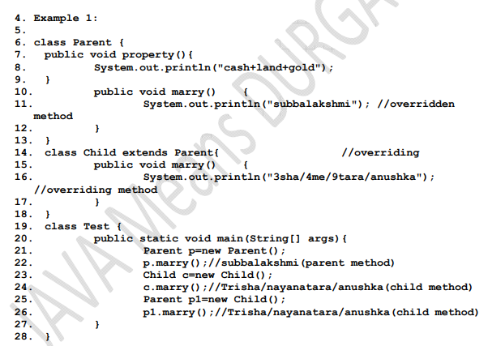

Slide 64
In overriding method names and arguments must be same. That is method signature must be same. 2. Until 1.4 version the return types must be same but from 1.5 version onwards covariant return types are allowed.
3. According to this Child class method return type need not be same as Parent class method return type its Child types also allowed.
4.
class Parent {
. public Object methodOne() {
7. return null; 8
. }
}
. class Child extends Parent
{
public String methodOne()
{
return null; 13.
} 14. }
javac -source 1.4 Parent.java //error

Slide 65
Three Pillars of OOPs

Slide 66
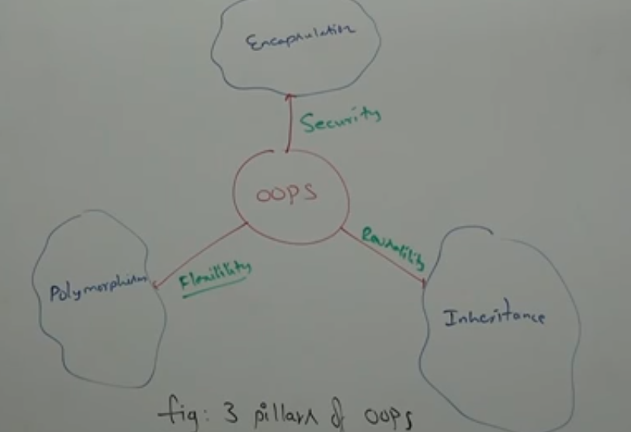

Slide 67
Parent class final methods we can override in the Child class.?
Example: class Parent
{
public final void methodOne()
{}
}
class Child extends Parent
{.
public void methodOne(){}
}

Slide 68
Output:
Compile time error: 26. methodOne() in Child cannot override methodOne() 27. in Parent; overridden method is final

Slide 69
We should override Parent class abstract methods in Child classes to provide implementation.?

Slide 70
abstract class Parent
{
public abstract void methodOne();
}
class Child extends Parent
{
public void methodOne() { }
}

Slide 71
While overriding we can't reduce the scope of access modifier.
class Parent {
.public void methodOne() { }
}
class Child extends Parent {
protected void methodOne( ) { }
}

Slide 72
Output: . Compile time error : methodOne() in Child cannot override methodOne() in Parent;
attempting to assign weaker access privileges; was public

Slide 73
What is the difference between interface and abstract class ?

Slide 74
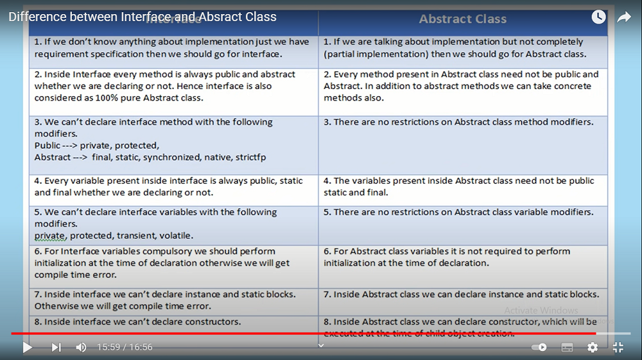

Slide 75
Interface | Abstract class
Requirement Specifications | Partial Implementations
Every methods public and abstract | Need not to be public abstract +concrete
We cant can’t take interface method as Public => private and protected Abstract :final,static ,syncronised,strictfp,native | No Restrictions
We can’t take interface variables as private protecte transient,volatile | No Restrictions
Compulsory initialization of variables | No Restrictions
We cant declare instance and static blocks | We can declare both
Declarations of constructor is not possible | We can declare constructor because we are not initialization every variable while declaring

Slide 76
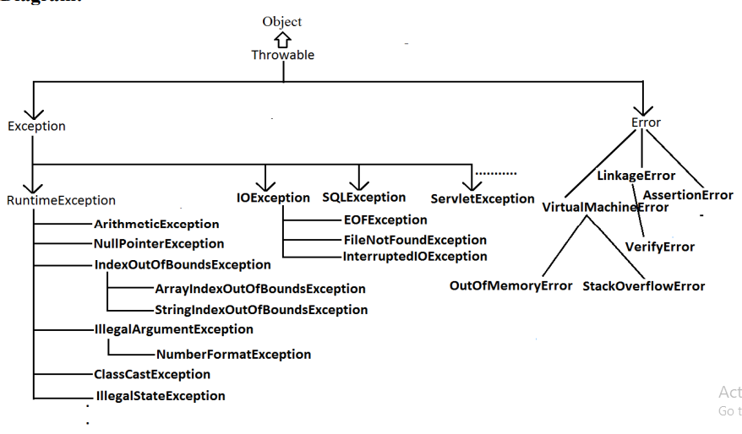

Slide 77
Rule: While overriding if the child class method throws any checked exception compulsory the parent class method should throw the same checked exception or its parent otherwise we will get compile time error. But there are no restrictions for un-checked exceptions.
Example: class Parent {
public void methodOne() {}
}
class Child extends Parent{
public void methodOne()throws Exception
{
}
}

Slide 78
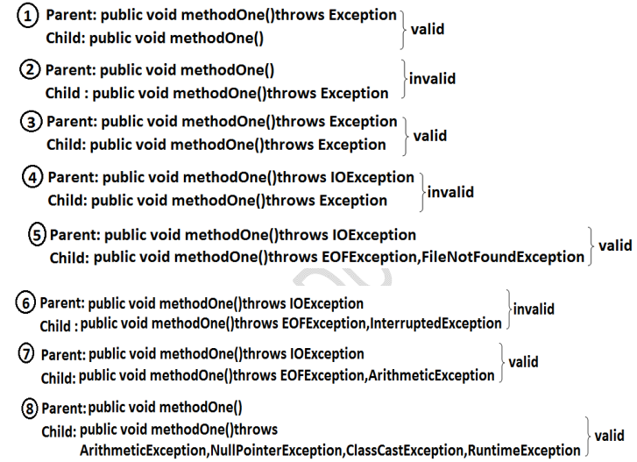

Slide 80
class Parent {
public static void methodOne()
{
}
//here static methodOne()
method is a class level
}
class Child extends Parent
{ public void methodOne()
{}
//here methodOne()
method is a object level hence // we can't override methodOne()
method }

Slide 81
class Parent {
public void methodOne()
{}
//here static methodOne()
method is a class level }
class Child extends Parent
{
public static void methodOne(){} //here methodOne()
method is a object level hence // we can't override methodOne()
method }

Slide 82
class Parent {
public static void methodOne()
{}
//here static methodOne()
method is a class level }
class Child extends Parent
{
public static void methodOne(){} //here methodOne()
method is a object level hence // we can't override methodOne()
method }

Slide 83
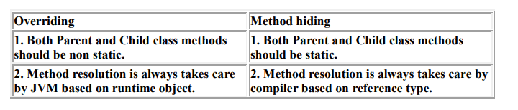
All rules of method hiding are exactly same as overriding except the following differences.

Slide 84
class Parent {
public static void methodOne()
{
System.out.println("parent class");
}
}
class Child extends Parent{
public static void methodOne()
{
System.out.println("child class");
}
}
class Test{ public static void main(String[] args) {
Parent p=new Parent();
p.methodOne();
Child c=new Child();
c.methodOne();
Parent p1=new Child();
p1.methodOne();
}
}

Slide 85
Parent class
Child class
Parent class

Slide 86
class Parent {
public void methodOne()
{
System.out.println("parent class");
}
}
class Child extends Parent{
public void methodOne()
{
System.out.println("child class");
}
}
class Test{ public static void main(String[] args) {
Parent p=new Parent();
p.methodOne();
Child c=new Child();
c.methodOne();
Parent p1=new Child();
p1.methodOne();
}
}

Slide 87
Parent class
Child class
Child class

Slide 88
class Parent
{
public void methodOne(int... i)
{
System.out.println("parent class");
} }
class Child extends Parent
{
public void methodOne(int i) {
System.out.println("child class");
} }
class Test { public static void main(String[] args)
{
Parent p=new Parent();
p.methodOne(10);
Child c=new Child();
c.methodOne(10);
Parent p1=new Child();
p1.methodOne(10);

Slide 89
class Parent
{
public void methodOne(int... i)
{
System.out.println("parent class");
} }
class Child extends Parent
{ //overloading but not overriding.
public void methodOne(int i) {
System.out.println("child class");
} }
class Test { public static void main(String[] args)
{
Parent p=new Parent();
p.methodOne(10); //parent class
Child c=new Child();
c.methodOne(10);//child class
Parent p1=new Child();
p1.methodOne(10);//parent clas

Slide 90
class Parent {
int x=888;
}
class Child extends Parent
{
int x=999;
}
class Test
{
public static void main(String[] args)
{
Parent p=new Parent();
System.out.println(p.x);
Child c=new Child();
System.out.println(c.x);
Parent p1=new Child();
System.out.println(p1.x);
} }

Slide 91
class Parent {
int x=888;
}
class Child extends Parent
{
int x=999;
}
class Test
{
public static void main(String[] args)
{
Parent p=new Parent();
System.out.println(p.x);//888
Child c=new Child();
System.out.println(c.x);//999
Parent p1=new Child();
System.out.println(p1.x);//888
} }

Slide 92
Differences Between Overloading and Overriding ?

Slide 93
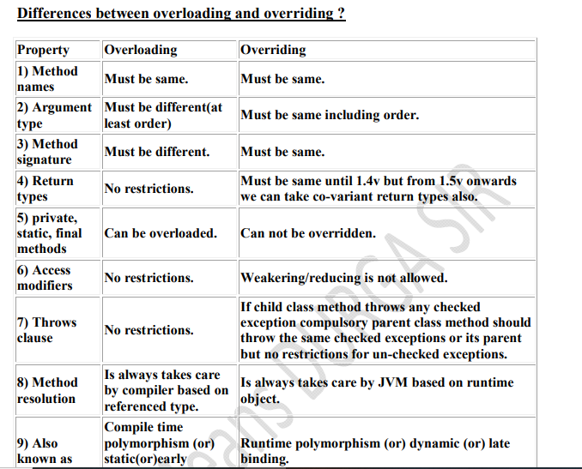

Slide 94
In overloading we have to check only method names (must be same) and arguments (must be different) the remaining things like return type extra not required to check.
2. But In overriding we should compulsory check everything like method names, arguments, return types, throws keyword, modifiers etc

Slide 95
Consider the method in parent class Parent: public void methodOne(int i)throws IOException
In the child class which of the following methods we can take..
1. public void methodOne(int i)
2. private void methodOne()throws Exception
3. public native void methodOne(int i);
4. public static void methodOne(double d)

Slide 96
Parent Mehtods:
public void methodOne(int i)throws IOException
Childs Methods:
public static void methodOne(int i);
public static abstract void methodOne(float f)

Slide 97
Differences ?
ArrayList al=new ArrayList();
[Child c=new Child();]
List l=new ArrayList();
[Parent p=new Child();]

Slide 98
In how many ways we can create an object ? (or) In how many ways get an object in java ?

Slide 99
By using new Operator :
Test t = new Test();
By using newInstance() :(Reflection Mechanism)
Test t=(Test)Class.forName("Test").newInstance();
By using Clone() :
Test t1 = new Test();
Test t2 = (Test)t1.Clone();
By using Factory methods :
Runtime r = Runtime.getRuntime();
DateFormat df = DateFormat.getInstance();
By using Deserialization :
FileInputStream fis = new FileInputStream("abc.ser");
ObjectInputStream ois = new ObjectInputStream(fis);
Test t = (Test)ois.readObject();

Slide 100
What is Constructors ?

Slide 101
Object creation is not enough compulsory we should perform initialization then only the object is in a position to provide the response properly.
2. Whenever we are creating an object some piece of the code will be executed automatically to perform initialization of an object this piece of the code is nothing but constructor.
3. Hence the main objective of constructor is to perform initialization of an object.

Slide 102
class Student {
String name; int rollno;
Student(String name,int rollno) //Constructor
{
this.name=name;
this.rollno=rollno;
}
public static void main(String[] args)
{
Student s1=new Student("vijayabhaskar",101);
Student s2=new Student("bhaskar",102);
}
}

Slide 103
Default constructor:

Slide 104
class Test { Test()
{
System.out.println("constructor");
super();
}
}

Slide 105
class Test
{
Test()
{
super();
this();
}
}

Slide 106
Differences between super() and this

Slide 107
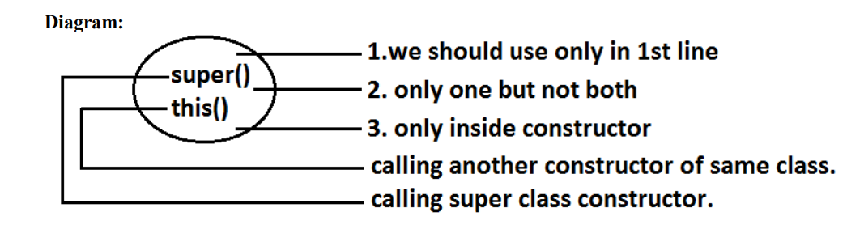

Slide 108
Overloaded constructors :

Slide 109
A class can contain more than one constructor and all these constructors having the same name but different arguments and hence these constructors are considered as overloaded constructors

Slide 110
class Test {
Test(double d)
{
System.out.println("double-argument constructor");
}
Test(int i) { this(10.5);
System.out.println("int-argument constructor");
}
Test()
{
this(10);
System.out.println("no-argument constructor");
}
public static void main(String[] args) {
Test t1=new Test();
Test t2=new Test(10);
Test t3=new Test(10.5);
} }

Slide 111
class Test {
Test(double d)
{
System.out.println("double-argument constructor");
}
Test(int i) { this(10.5);
System.out.println("int-argument constructor");
}
Test()
{
this(10);
System.out.println("no-argument constructor");
}
public static void main(String[] args) {
Test t1=new Test(); //no-argument constructor/int-argument //constructor/double-argument constructor
Test t2=new Test(10); //int-argument constructor/double-argument constructor Test t3=new Test(10.5);//double-argument constructor } }

Slide 112
Whenever we are creating child class object then parent class constructor will be executed.

Slide 113
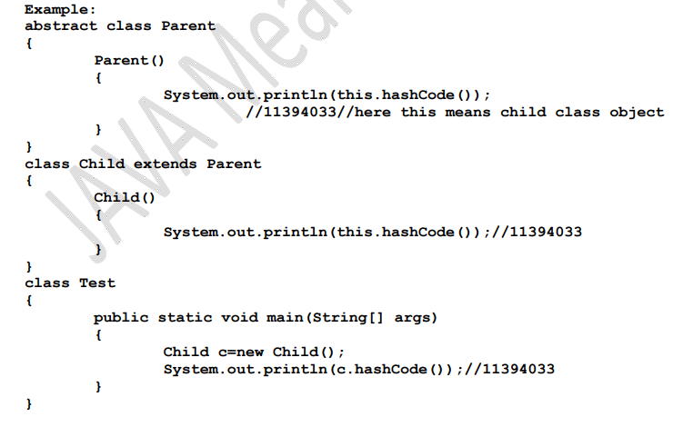

Slide 114
Recursive functions?

Slide 115
Recursive functions?
1. Nested call
2. Recursive call

Slide 116
. Nested call?

Slide 117
Calling a function inside another function is called nested call.
In nested call there is a calling function which calls another function(called function).
public static void methodOne()
{
methodTwo();
}
public static void methodTwo() {
methodOne();
}

Slide 118
Recursive call ?

Slide 119
Recursive call ?
Recursive call:
Calling a function within same function is called recursive call.
In recursive call called and calling function is same.
public void methodOne()
{
methodOne(); }

Slide 120
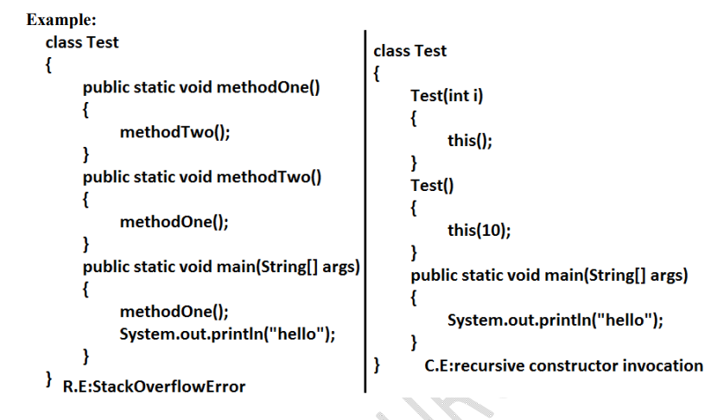

Slide 121
Singleton classes ?

Slide 122
Runtime class
ActionServlet
ServiceLocator
BusinessDelegate

Slide 123
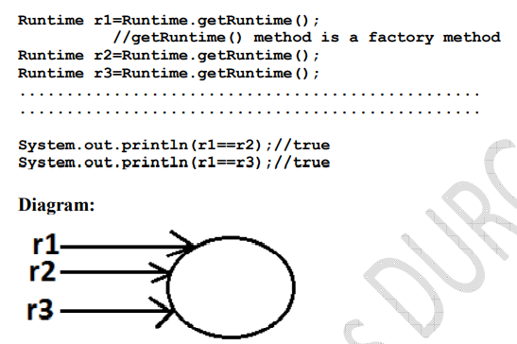

Slide 124
Advantages of Singleton class?

Slide 125
Advantage of Singleton class :
If the requirement is same then instead of creating a separate object for every person we will create only one object and we can share that object for every required person we can achieve this by using singleton classes. That is the main advantages of singleton classes are Performance will be improved and memory utilization will be improved

Slide 126
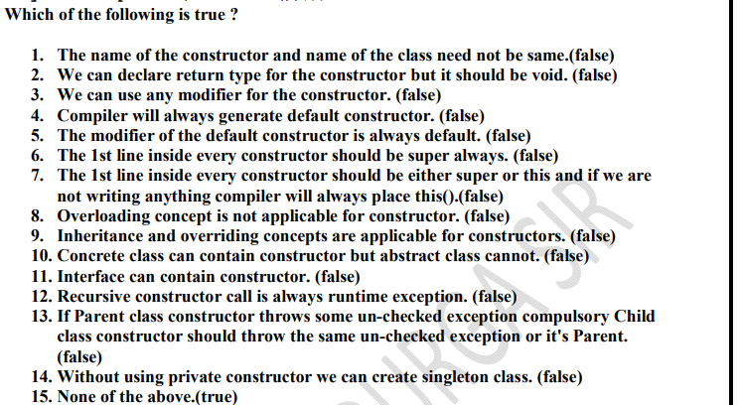

Slide 127
Factory method:

Slide 128
Factory method:
By using class name if we are calling a method and that method returns the same class object such type of method is called factory method.
Example: Runtime r=Runtime.getRuntime();//getRuntime is a factory method.
DateFormat df=DateFormat.getInstance();

Slide 129
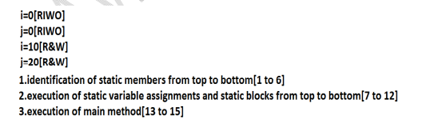
Static control flow ?

Slide 130
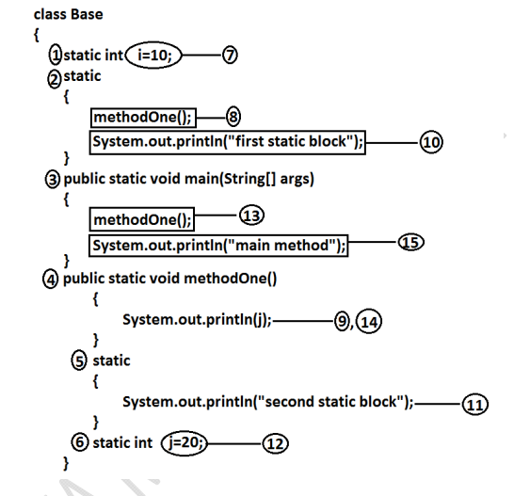

Slide 131
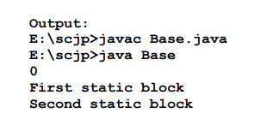

Slide 132
Read indirectly write only state (or) RIWO :?

Slide 133
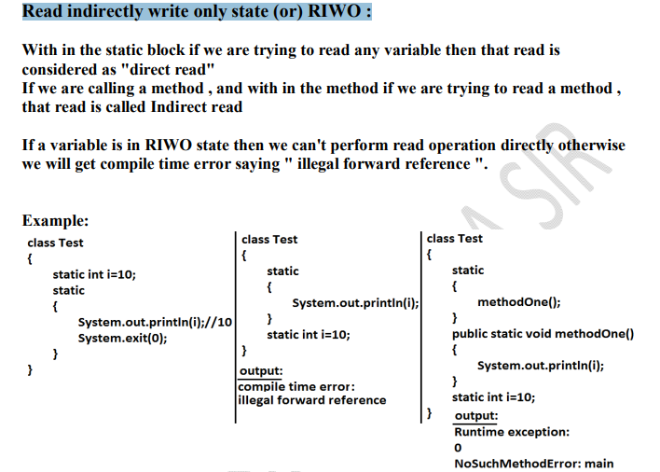

Slide 134
Static control flow with respect to inheritance ?

Slide 135
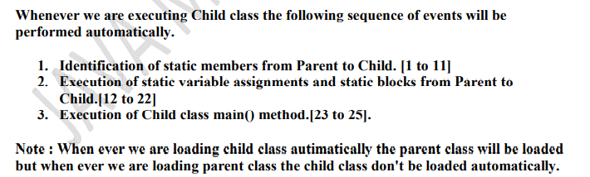

Slide 136
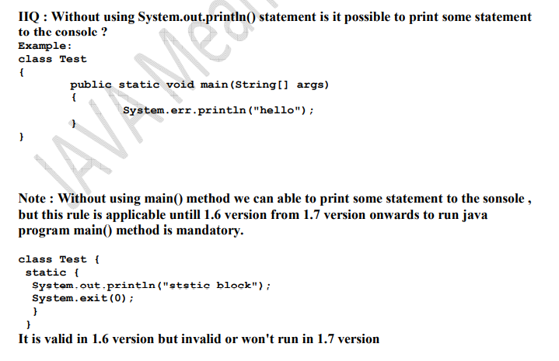

Slide 137
Instance control flow:?

Slide 138
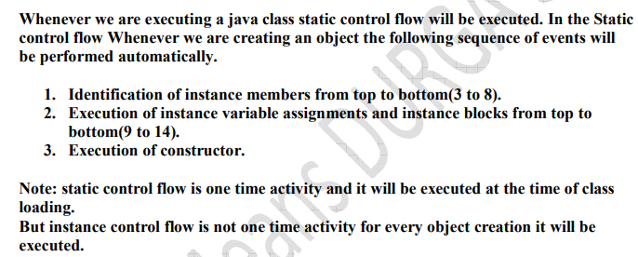

Slide 139
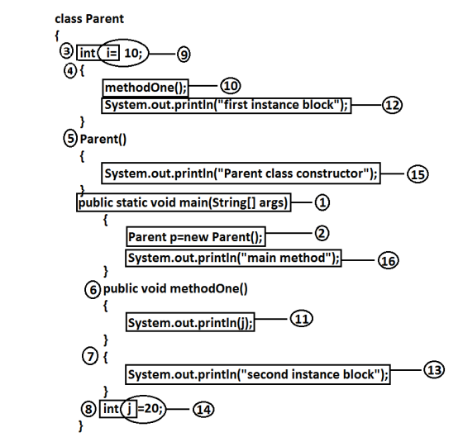
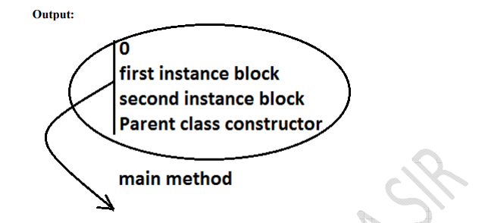

Slide 140
Parent to child Instance control flow

Slide 141
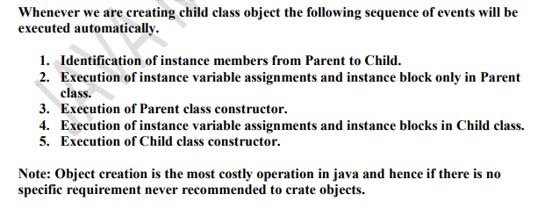

Slide 142
Object Type casting ?

Slide 143
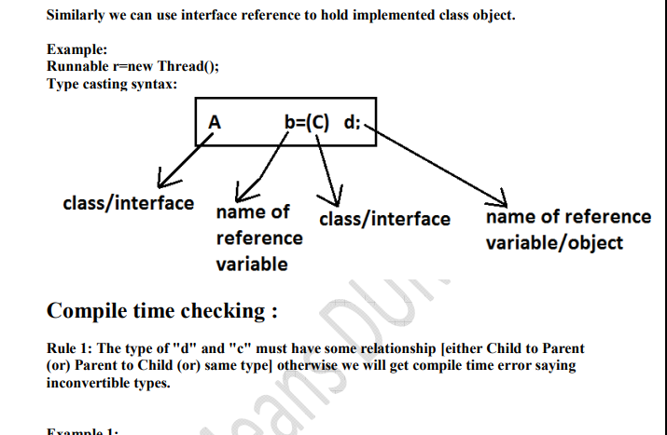

Slide 144
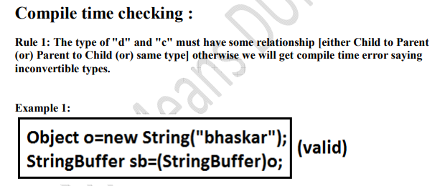

Slide 145
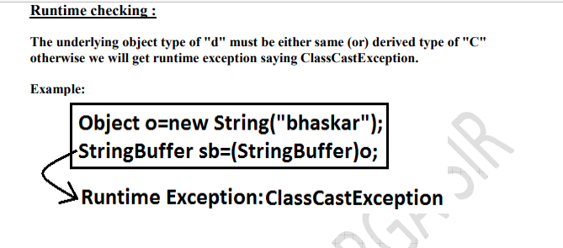

Slide 146
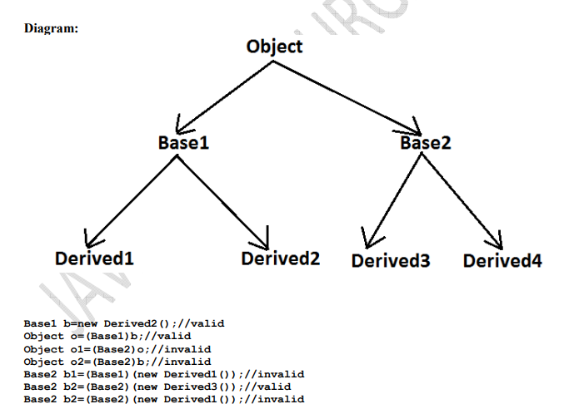

Slide 147
What is Coupling ?

Slide 148
The degree of dependency between the components is called coupling.
Example: class A
{ static int i=B.j;
}
class B extends A
{
static int j=C.methodOne();
} class C extends B
{ public static int methodOne()
{
return D.k;
} }
class D extends C
{
static int k=10; public static void main(String[] args)
{
D d=new D();
}
}
The above components are said to be tightly coupled to each other because the dependency between the components is more.

Slide 149
For every component we have to maintain a clear well defined functionality such type of component is said to be follow high cohesion

Slide 150
